Slide 1

Diabetes Readmission Prediction
- Vasanthi Kolachalama
Pg. ID: 11810072
Karamsetty Venkata Subba Akhilesh
Pg. ID: 11810115

Slide 2
1) Abstract
The Primary focus of the hosipitals is to improve the outcomes and create satisfied patients
Hospitals are incurring heavy losses due to high Readmission rate of Diabetic Patients in US
By predicting the probability of the new patient getting readmitted within 30 Days, we can identify various ways to avoid that by giving better precautionary measures
This project deals with finding the Key Factors that influence the probability of the patient getting readmitted in the hospital within 30 days
In the process of finding those Key Factors we are focussing on building Machine Learning model like Random Forest and the have to build Logistic Regression Model to predict the probability of readmission and looking to select the best model with higher accuracy

Slide 3
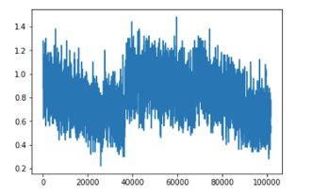
2) Business Problem
Diabetes is a medical condition that is caused due to insufficient production and secretion of insulin from the pancreas in case of Type-1 diabetes and defective response of insulin Type-2 diabetes
Readmission of Diabetic Patients in the Hospitals is highly expensive due to the penalties faced by the hospitals if the readmission rate is higher than expected
The main goal of most of the hospitals are focused on improving the outcomes as well as creating more number of satisfied patients and better overall value
Hence, it is important for the hospitals to focus more on reducing the readmission rates to avoid the penalties
We have to identify the Significant features that influence the readmission for diabetic patients and to predict the probability of their readmission
The graph shown beside is data falling under the readmisison criteria
as we have defined in the data cleaning section

Slide 4
3) Data Collection
The dataset has been extracted from UCI Machine Learning Repository and the dataset represents 10 years (1999-2008) of clinical care at 130 US hospitals and integrated delivery networks
https://archive.ics.uci.edu/ml/datasets/Diabetes+130-US+hospitals+for+years+1999-2008#
The dataset includes around1,00,000 observations and 50 columns such as patient number, race, gender, age, admission type, time in hospital, medical specialty of admitting physician, number of lab test performed, HbA1c test result, diagnosis, number of medication, diabetic medications, number of outpatient, inpatient, and emergency visits in the year before the hospitalization, etc

Slide 5
4) Data Cleaning
We considered the patients who are getting ‘readmitted’ as the dependent variable and divided them into the 3 categories, <30, >30 & No into 2 levels, <30 as 1 and both >30 & No as 0. This we are terming as the readmission criteria for the next slides
We have ignored the features, ‘weights’, ’payers’ & ‘Medical_Speciality’ as they have many null values
There are a few diagnosis features such as ’diag_1’, ‘diag_2’, ‘diag_3’. we have mapped those levels to ICD9 codes and reduced to 18 levels for those diagnosis features
We have checked the value counts of the race of the people who are readmitted
We have done Feature Engineering by combining the features, ‘outpatient_visits’, ‘inpatient_visits’ and ‘emergency_visits’ to ‘total_visits’ by adding up the values of the 3 features

Slide 6
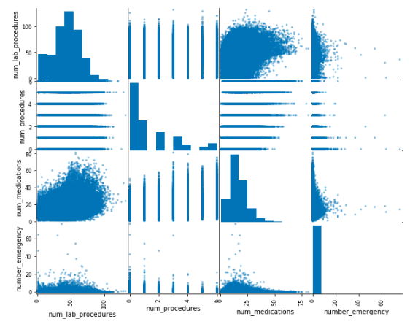
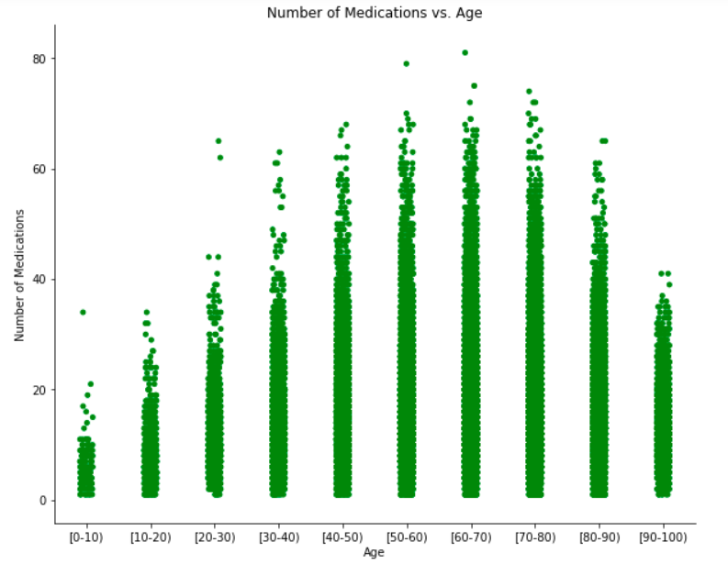
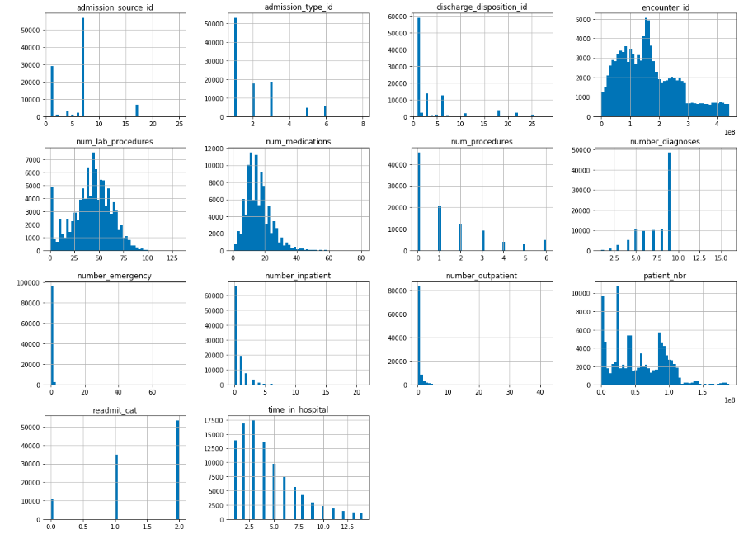
5) Data Understanding(EDA)
Number of medications taken by the patients vs Age of the patients. The age 60-70 band takes more number of medications
Histograms of all the columns used as part of EDA
Scatterplot showing the readmission criteria like number of lab procedures, procedures, medications and emergency number.

Slide 7
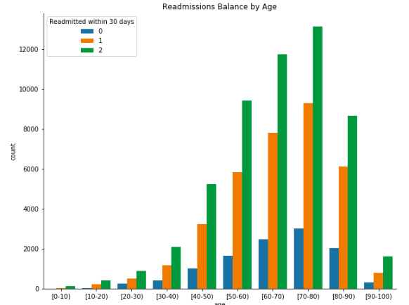
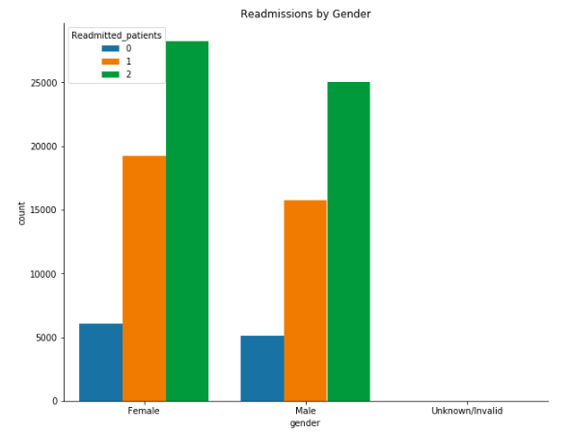
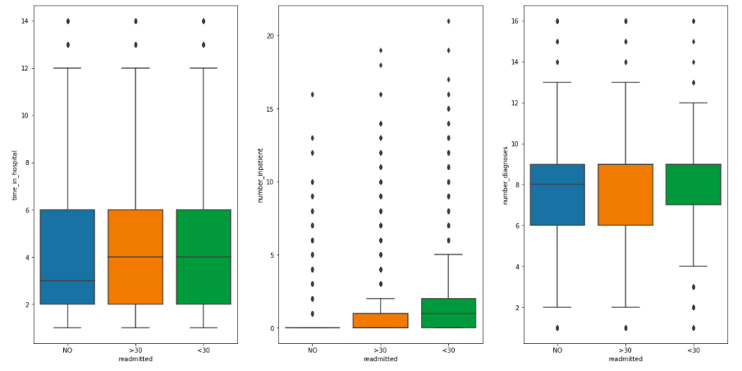
Here we can see the readmission pattern based on age band. So the age band of 70-80 has the highest readmission numbers.
The readmission pattern based on gender. More females are readmitting to the hospitals based on the graph.
Boxplot showing the readmission criteria like time in the hospital, number of inpatients, and number of diagnosis.

Slide 8
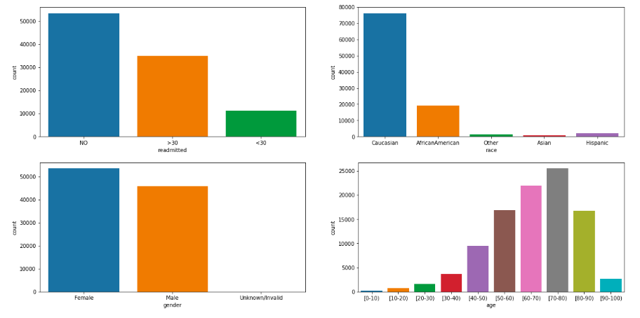
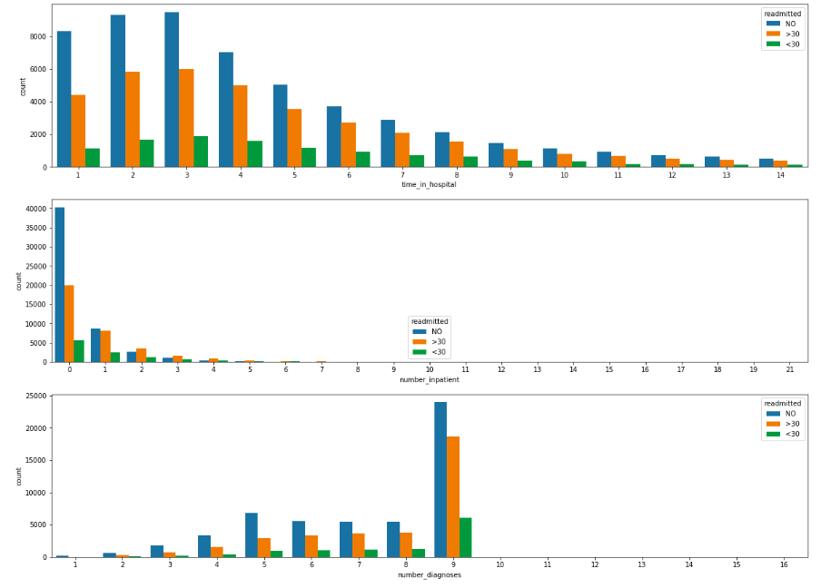
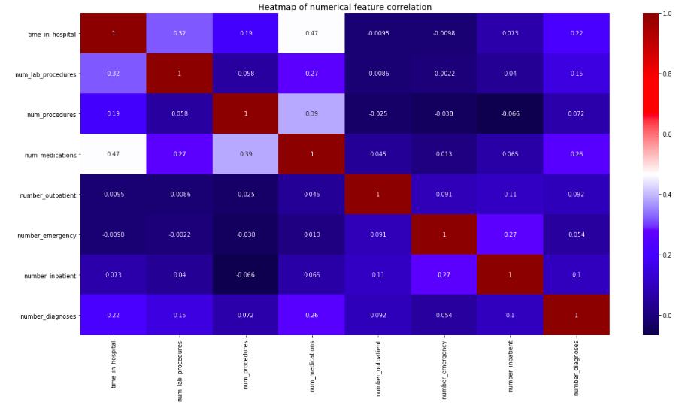
Plots showing the data variation using the readmission criteria in columns like gender, race and age.
Readmission pattern based on time in the hospital, inpatient count and number of diagnosis
Correlation matrix for all the required columns is showing that there is no much correlation between any of the columns for prediction.

Slide 9

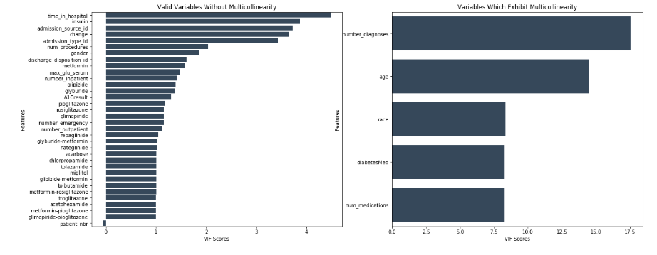
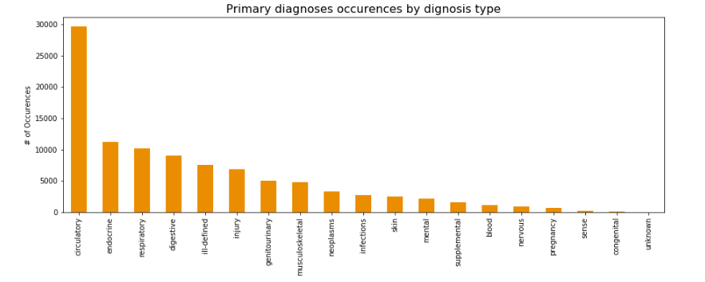
The count of the readmission criteria that is <30 is shown as 46816.
The graph shows the Primary diagnosis occurrences by diagnosis type. Circulatory diagnosis shows high numbers.
Above graph shows the VIF scores for variables with multicollinearity and without multicollinearity

Slide 10
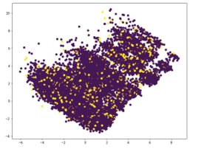
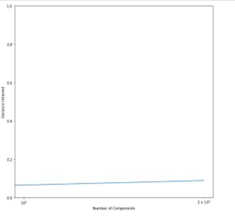
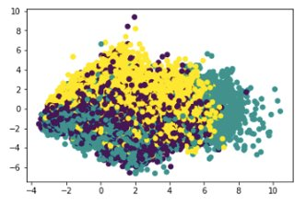
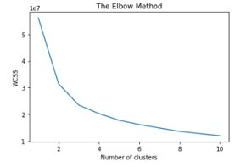
5) Modeling
As a first step, we have converted all the categorical variables into dummy variables and we found there are 102 columns
To reduce the dimensionality of the dataset, we have used PCA and clsutering methods but we got very less variance and all the co clusters have been formed

Slide 11
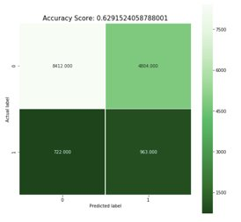
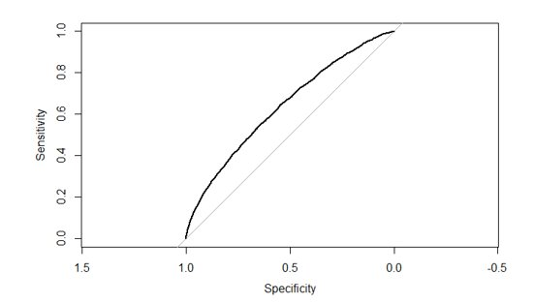
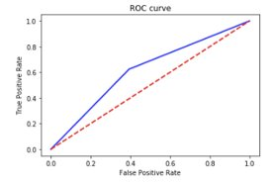
Modeling Contd..
Next we applied logistic regression on the dummy variables which we have converted. In the first run we got an accuracy of 62% which is not relevant. So we have applied step wise logistic regresison and then we got a 88% of accuracy
For diagnosis. we have done the Hosmer-Lemeshow test, we got a p value greater than 0.05. Hence we accept the null hypothesis(i.e the logistic model fits the data)
In the Random Forest method we got the key factors(significant features from the model with higher accuracy. By focussing on the key factors the hospitals can avoid readmission and penalties
Above graph shows the usage of the ROC curve which displays false positive rate and true positive rate
Beside graph shows the ROC curve
Above figure shows a heatmap showing the accuracy score for actual and predicted

Slide 12
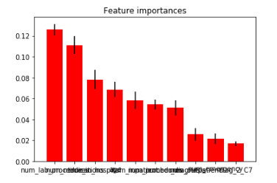
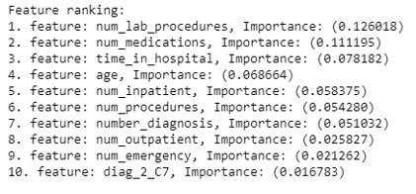
6) Business Recommendations
We have got the key factors from the Model with higher accuracy.
By focusing on the key factors, the hospitals can avoid the penalties by predicting which diabetic patients will be readmitted again within 30 days and which patients will not.
Above graph shows the feature importance

Slide 13
7) Assumptions, Limitations & Future Work
Assumptions:
We have given equal weightage to all types of visits and to all the drugs
We have considered equal importance to all types of diagnosis
Limitations:
Readmission rate would vary based on procedures undergone, drugs used and the self care taken by the patient
But in this analysis, equal weightage to all the procedures and drugs has been given. This might be a limitation because every patient admitted would be different and would be followed different diagnosis
Future Work:
We can further update the dataset, by adding the type of diagnosis taken and new drug types
We can build the Deep Learning Models to find the Key factors and predict the probability of readmission on a broader scope

